Slide 1
GA prototype

Slide 2

RP FinBank
Log in Sign up
Resources Services Investment Ideas About Us Contact Us
Serving you with a smile

Slide 3
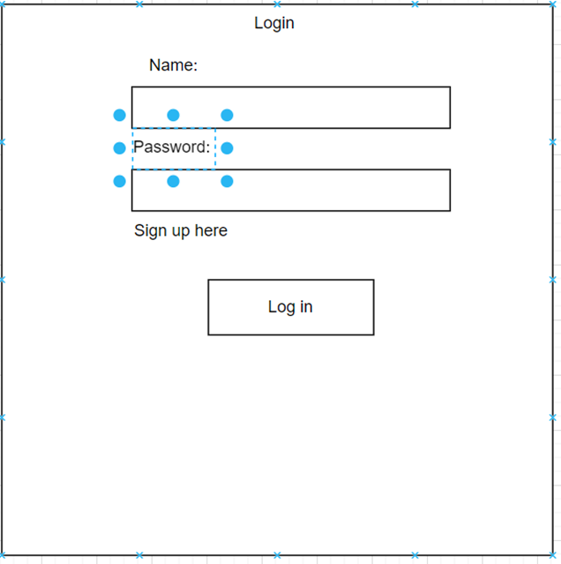

Slide 4
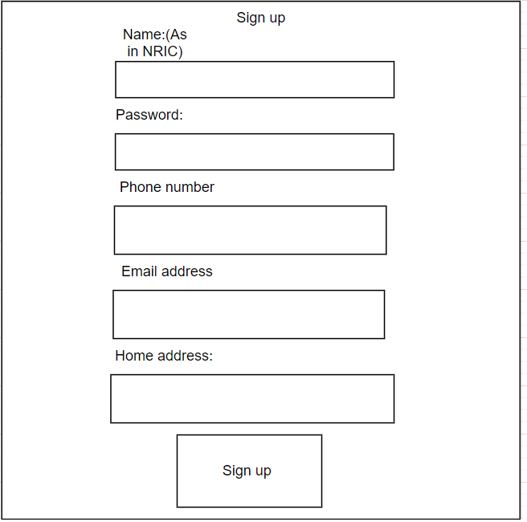

Slide 5
Contact Us
Phone number:+6581234567
Email address:22010944@myrp.edu.sg
Client Service Suggestions
We pride ourselves on providing the highest levels of client service to you. If however, you have any feedback about one of your investments with us or any aspect of the service you feel that we have fallen short of your expectations, we would like to hear from you.

Slide 6
About us
Values and beliefs of the business:
Proper investing:
Description
Our culture:
Description
Investment expertise: Description
Clear and reachable goals:
Description
Description- A short description will be added to include a brief description of each.

Slide 7
Services
Asset management
Advisory services

Slide 8
Investments ideas
Stocks
ETF
Mutual funds
Derivatives
Bonds
Real Estate

Slide 9
Resources:
For more reading on each of the different assets type:
Stocks:
Articles
ETF:
Articles
Mutual funds:
Articles
Derivatives:
Articles
Bonds:
Articles
Real Estate:
Articles
Articles- Include news, articles, videos to know more.

